Slide 1
Dual Credit & Secondary Partnerships
TVCC Dual Credit Student Meeting
Mary Helen Kelm – Director of Dual Credit

Slide 2
Dual Credit & Secondary Partnerships
Dual Credit refers to a system under which an eligible high school student enrolls in college course(s) and receives credit for the course(s) from both the college and the high school. Dual Credit courses include both academic core courses as well as technical/workforce courses.

Slide 3
Benefits of Dual Credit
Provides a challenge for those students who want it.
Shortens the time for completion of a degree or certificate, while assisting in the transition to college.
Reduces the cost of higher education.
Graduates can enter the workforce sooner.
Students gain confidence in their educational abilities.
Dual Credit & Secondary Partnerships

Slide 4
What do I want from Dual Credit?
Associate’s Degree
Core Complete
A few credits to take with me to another institution
A workforce certificate

Slide 5
Dual Credit Academic Courses (Available face-to-face, online, and Zoom)
Associate Degree Requirements
Course | Hours
Communications | 6
Creative Arts | 3
Component Area Option | 6
Program Electives | 16
Government | 6
History | 6
Language, Philosophy & Culture | 3
Math | 3
Life & Physical Science | 8
Social/Behavioral Sciences | 3
Total | 60
Dual Credit & Secondary Partnerships

Slide 6
Dual Credit Academic Courses (Available face-to-face, online, and Zoom)
Core Complete Requirements
Course | Hours
Communications | 6
Creative Arts | 3
Component Area Option | 6
Government | 6
History | 6
Language, Philosophy & Culture | 3
Math | 3
Life & Physical Science | 8
Social/Behavioral Sciences | 3
Total | 44
Dual Credit & Secondary Partnerships

Slide 7
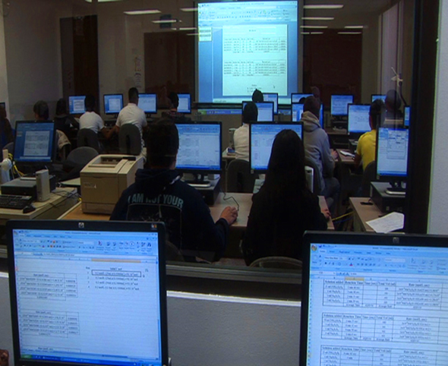
Early College Program in Workforce Certificates (Available face-to-face and online)
Lead to workforce certificates (9-32 SCH)
Leas to Associate Degree (AAS-60 SCH)
Lead to industry certifications
https://coursecatalog.tvcc.edu/pathways
Workforce Pathways:
Basic Automotive Technology
Business Technology
Lineworker
HVAC
Cosmetology
Medical Nursing Assistant (CNA)
Networking & Information Security (Computers)
Criminal Justice
Ranch Management
Cybersecurity
Welding
Dual Credit & Secondary Partnerships

Slide 8
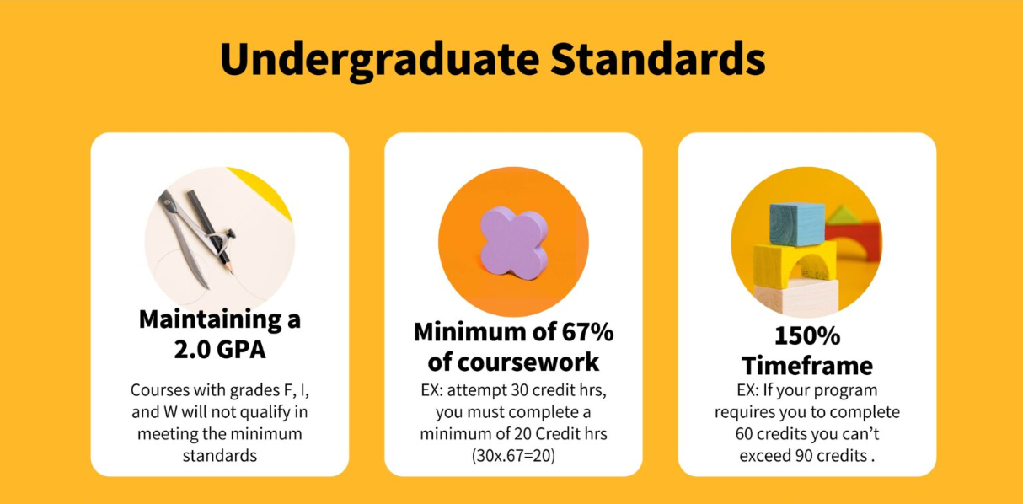
SAP – Satisfactory Academic Progress Satisfactory Academic Progress (SAP) is a federal requirement financial aid recipients must meet to establish or maintain financial aid eligibility.

Slide 9
Meet TVCC admissions, testing and vaccination guidelines
Incoming freshman & sophomores must submit additional information and must pass the TSIA ENGL and have a HS GPA of 3.0prior taking any academic dual credit classes.
Dual Credit students are limited to 18 semester credit hours (SCH) per semester (additional hours upon TVCC approval)
Enroll with the TVCC Dual Credit/Concurrent Registration Form, with student, parent and counselor signatures at TVCC.edu
High schools may have their own program applications procedures in place, including UIL eligibility
Final grades are transcripted upon completion of the course
Student Eligibility & Enrollment
Dual Credit & Secondary Partnerships

Slide 10
Hours | Regular Tax-Paying District | Out of Tax-Paying District
1
2
3 | $147 | $180
4 | $196 | $240
5 | $245 | $300
6 | $294 | $360
7 | $382 | $524
8 | $470 | $688
9 | $558 | $852
10 | $646 | $1016
11 | $734 | $1180
12 | $822 | $1344
13 | $910 | $1508
14 | $998 | $1672
15 | $1086 | $1836
Tax-Paying District: Tuition: $39 per semester hour General Fee: $49 per semester hour, maximum of $999
Dual Credit & Secondary Partnerships
Additional Fees
$40 internet fee for each distance learning course
$100 reinstatement fee for students reinstated after the official census date
$117 per credit hour fee for courses taken the third time and each time thereafter
$25 installment plan fee if tuition and fees are paid using the college’s installment payment plan; 10% down payment required for a student to enter into an installment plan
$35 standard lab fee. Some designated individual courses with labs contain fees higher than $35. Refer to the course descriptions in this catalog for these standard and designated lab fees
Bookstore Fee – varies with cost of digital materials
Dual Credit student receive a tuition waver for the 1st 2 classes. They pay only fees. Any additional classes are charged normal tuition and fees.

Slide 11
Out of Tax-Paying District General fee: $60 per semester hour for 2 classes
Then
Tuition: $39 per semester hour
General Fee: $49 per semester hour
Out of District fee: $76 per semester hour
Hours | Regular Tax-Paying District | Out of Tax-Paying District
1
2
3 | $147 | $180
4 | $196 | $240
5 | $245 | $300
6 | $294 | $360
7 | $382 | $524
8 | $470 | $688
9 | $558 | $852
10 | $646 | $1016
11 | $734 | $1180
12 | $822 | $1344
13 | $910 | $1508
14 | $998 | $1672
15 | $1086 | $1836
Dual Credit & Secondary Partnerships
Additional Fees
$40 internet fee for each distance learning course
$100 reinstatement fee for students reinstated after the official census date
$117 per credit hour fee for courses taken the third time and each time thereafter
$25 installment plan fee if tuition and fees are paid using the college’s installment payment plan; 10% down payment required for a student to enter into an installment plan
$40 standard lab fee. Some designated individual courses with labs contain fees higher than $35. Refer to the course descriptions in this catalog for these standard and designated lab fees
Bookstore Fee – Varies with cost of digital materials
Dual Credit student receive a tuition waver for the 1st 2 classes. They pay only fees. Any additional classes are charged normal tuition and fees.

Slide 12
HB-8 FAST Program Began Fall 2023
All student qualifying for Free or Reduced Lunches at any point in the past 4 years may participate in Dual Credit classes for no charge.
FAST is only available for student currently enrolled in a public school.

Slide 13
TVCC Partnerships
TVCC partners with multiple ISDs, charter and private schools.
Each school is free to develop its own dual credit admission requirements, dual credit policies, approved courses, approved pathways, etc.
TVCC will honor and abide by the policies of each institution as long as those policies meet the minimum admission/enrollment requirements of TVCC.

Slide 14
Homeschool Partnerships
Each home/family signs a Partnership agreement with TVCC
A parent or guardian serves as the HS counselor and is responsible for helping the student with all registration processes.
The same admission requirements apply for all dual credit students.
Homeschool students are eligible for the same tuition waiver and Murchison award that is available for our ISD and private school students.

Slide 15
Getting Started

Slide 16
Dual Credit & Secondary Partnerships
All registration for students enrolled in an ISD, Charter or Public school is completed with the HS Counselor or Administration. DC students cannot self add or drop classes.
Institutions may have due dates that proceed those of TVCC in order to have materials submitted to us on time.
All homeschool registration is submitted by the parent or guardian through the TVCC website

Slide 17
TSIA Testing
TVCC.edu
Click Admissions
Click Take the TSIA
Click Need to Schedule an exam

Slide 18
TVCC.EDU

Slide 20
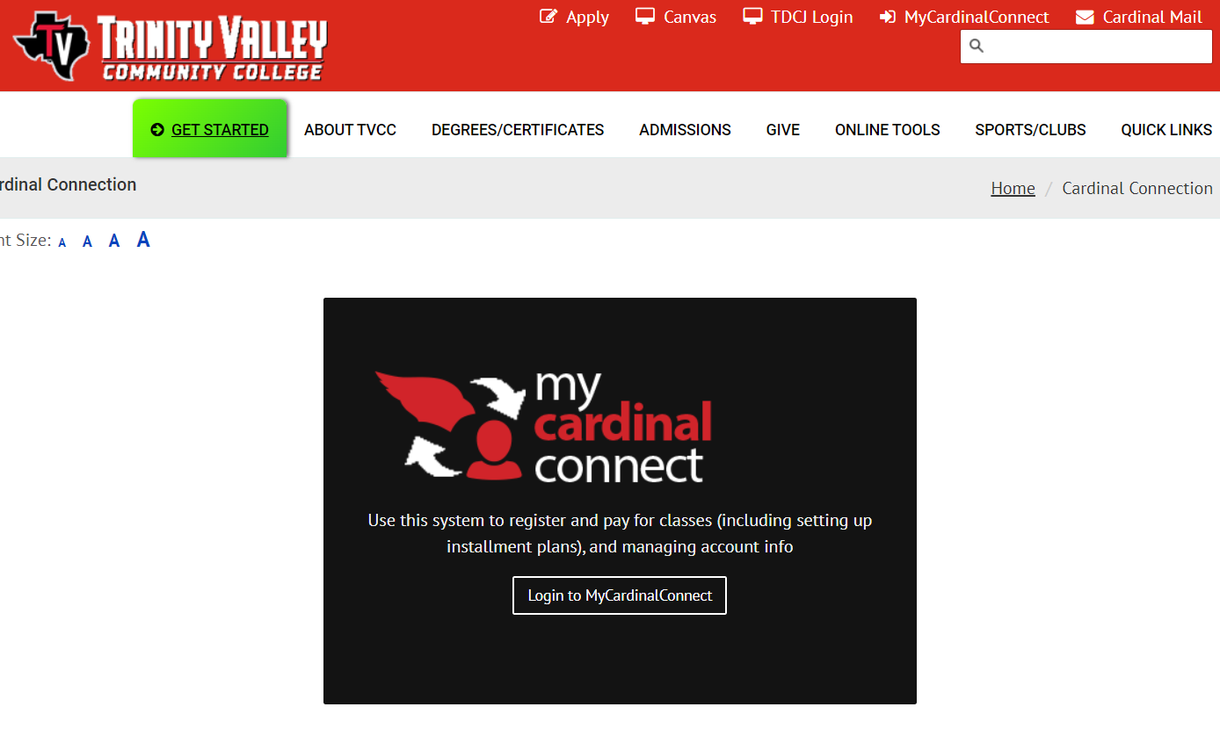
My Cardinal Connect
Access through TVCC.EDU
Use to make payments or set up payment plans
Or
Pay in person on campus at the cashier’s office
Dual Credit & Secondary Partnerships

Slide 21
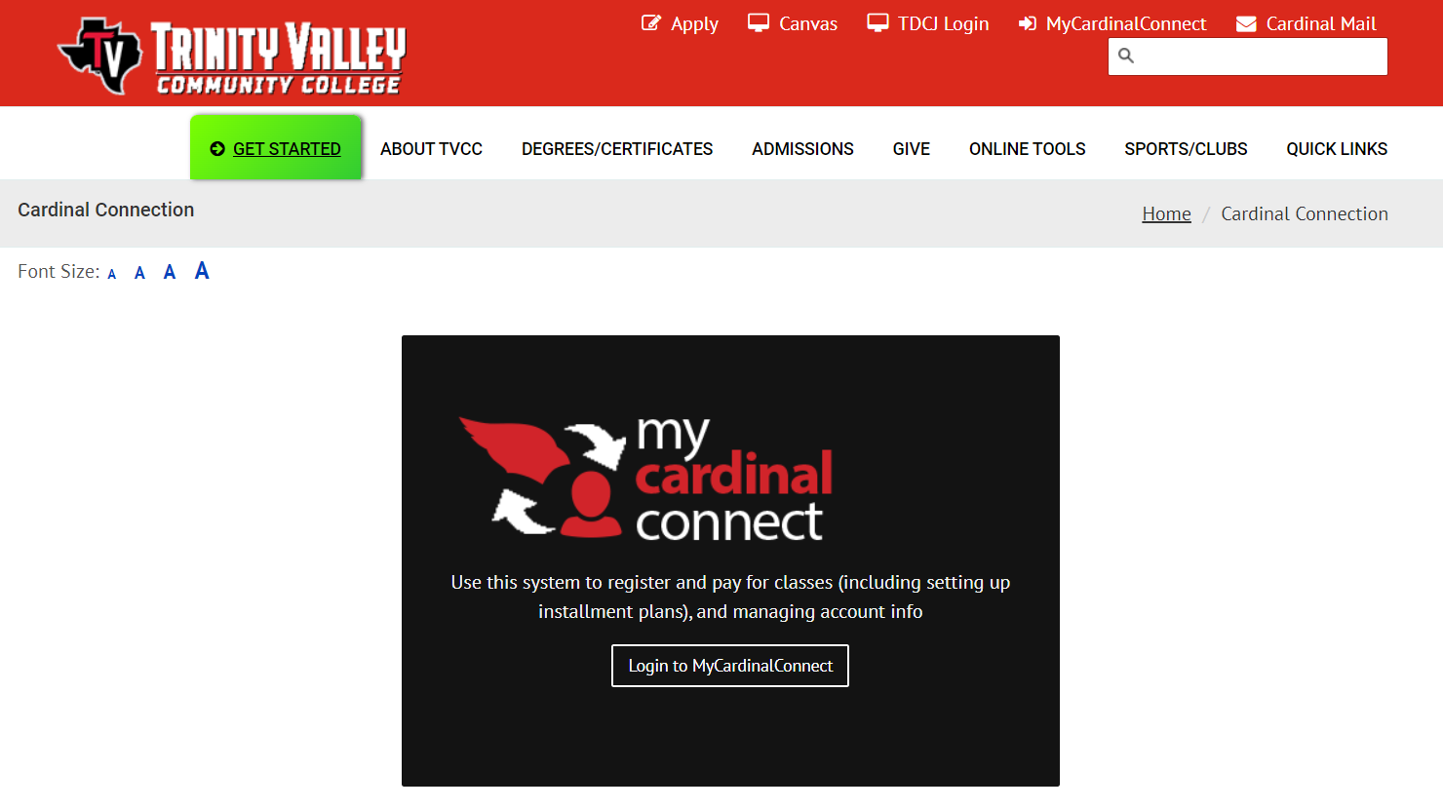
Communicate with instructors, billing office, dual credit, etc.
Dual Credit & Secondary Partnerships

Slide 22
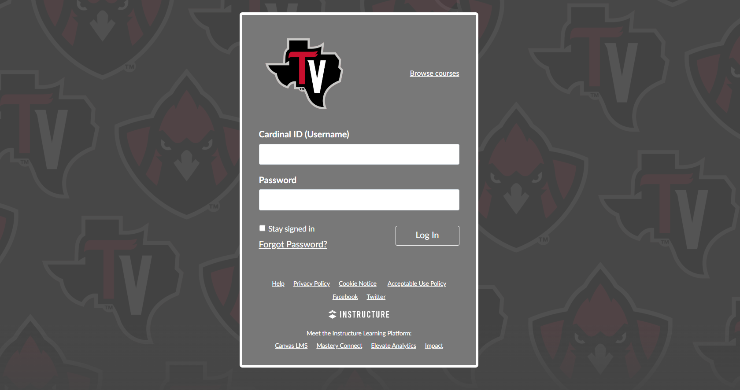
Dual Credit & Secondary Partnerships

Slide 23
Family Education Rights & Privacy Act
The Family Educational Rights and Privacy Act (FERPA) (20 U.S.C. § 1232g; 34 CFR Part 99) is a Federal law that protects the privacy of student education records. The law applies to all schools that receive funds under an applicable program of the U.S. Department of Education.
FERPA gives parents certain rights with respect to their children's education records. These rights transfer to the student when he or she reaches the age of 18 or attends a school beyond the high school level. Students to whom the rights have transferred are "eligible students."
TVCC employees are not allowed to discuss individual students with anyone, including parents, without a signed FERPA Waiver. TVCC staff will communicate to the high school, where parents may request information from the high school staff regarding students’ dual credit courses.
Dual Credit & Secondary Partnerships

Slide 24
Student Support Services
Library
www.libguides.tvcc.edu
Mentoring
www.tvcc.edu/cardinal-success-center
Student Support Services
www.tvcc.edu/advisement
Tutoring
www.tvcc.edu/cardinal-success-center
Disability Services
www.tvcc.edu/Cardinal-Success-Center
Veteran’s Financial Aid
www.tvcc.edu/veterans
Dual Credit & Secondary Partnerships
Activate your TVCC Cardinal Email and obtain your TVCC Student ID Card for access to the above services

Slide 25
Textbooks
Can be purchased at the TVCC Bookstore in person
Can be purchased at the online TVCC Bookstore
Can be purchased or rented online, at various websites.
www.chegg.com
www.campusbooks.com
www.cheaptextbooks.com
www.amazon.com
Dual Credit & Secondary Partnerships
Some courses now use OER (Open Educational Resources). These courses have no instructional materials fees.

Slide 26
Dual Credit Website
Contents of this power point presentation
Tabs for parents, students and school counselors
Dual Credit Student Orientation
Forms
Student Handbooks
Course Crosswalk
More facts about Dual Credit
Calendar of Important Dates
Dual Credit & Secondary Partnerships
www.tvcc.edu/dual-credit

Slide 27
College Classes
Dual Credit Classes are true college classes.
The grades will appear on a college transcript.
The classes will be taught to the rigor and difficulty of a college class.
A dual credit student is a college student and is responsible for all communication with instructors.
The content in college classes may be more mature that that typically presented in a HS class. Students and parents should read course syllabi to understand what will be covered in the course.
The college instructor is not held to the same requirements as a HS instructor in terms of number of assignments required, frequency of grades posted, reminders, acceptance of late work, ability to retake tests or make up work, etc. Students and parents should read course syllabi to understand what will be covered in the course.
Plagiarism – Students need to be very aware of the consequences of plagiarism including the use of AI. All student papers are run through a program that will detect all forms of plagiarism. The consequences range from redoing the assignment to failing the course.

Slide 28
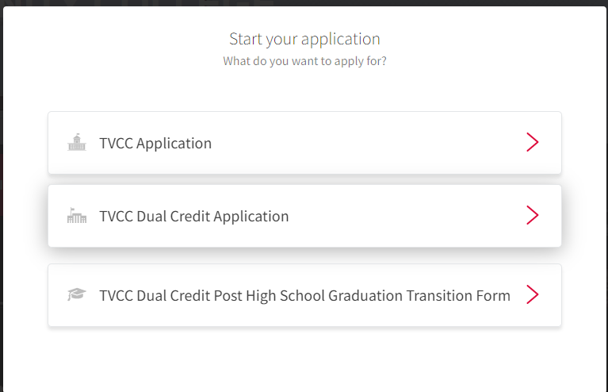

Slide 29
Thank you!
Dual Credit & Secondary Partnerships
Mary Helen Kelm
mary.kelm@tvcc.edu
Trinity Valley Community College does not discriminate on the basis of race, color, national origin, sex, disability or age in its programs or activities. For questions or concerns regarding discrimination based on sex, including sexual harassment, contact: Director of Human Resources/Title IX Coordinator, 100 Cardinal Drive, Athens, TX 75751, 903-675-6215, humanresources@tvcc.edu . For questions or concerns regarding discrimination based on a disability, contact ADA/Section 504 Coordinator, 100 Cardinal Drive, Athens, TX 75751, 903-670-2068, disability@tvcc.edu .
.

